Slide 1
National Biophysical Parameter Production Using GEE LEAF Production Tool
Lixin Sun and Richard Fernandes
Canada Centre for Mapping and Earth Observation
Natural Resources Canada
Notes:
This presentation will provide an overview on the production system for generating national biophysical maps

Slide 2
The LEAF Toobox and The LEAF Production Tool
Both tools were developed based on the Google Earth Engine (GEE) APIs. The LEAF production tool was created from the concepts implemented in the LEAF Toolbox.
(2) Different user interface. Graphic user interface vs a parameetr dictionary.
(3) Different output spatial unit. The LEAF toolbox applies the LEAF algorithm to a single scene, while the LEAF production tool applies the LEAF algorithm to a mosaic image.
(4) Different programming languages. They are debveloped using Javascript and python,respectively. The following benefits can be obtained by using GEE Python API:
Result exporting processes can be fully automated.
Be able to use Google Cloud Service Account so that customized resources can be reserved and utilized.
The status of exporting tasks can be programmingly monitored.
In addition to GEE APIs, standard Python APIs can also be integrated into the development.
Professional IDE (e.g., Visual Studio Code) and Version Control System (e.g., GitHub) can be utilized in software development.
Notes:
The reason why Python language was chosen to develop LEAF Production tool

Slide 3
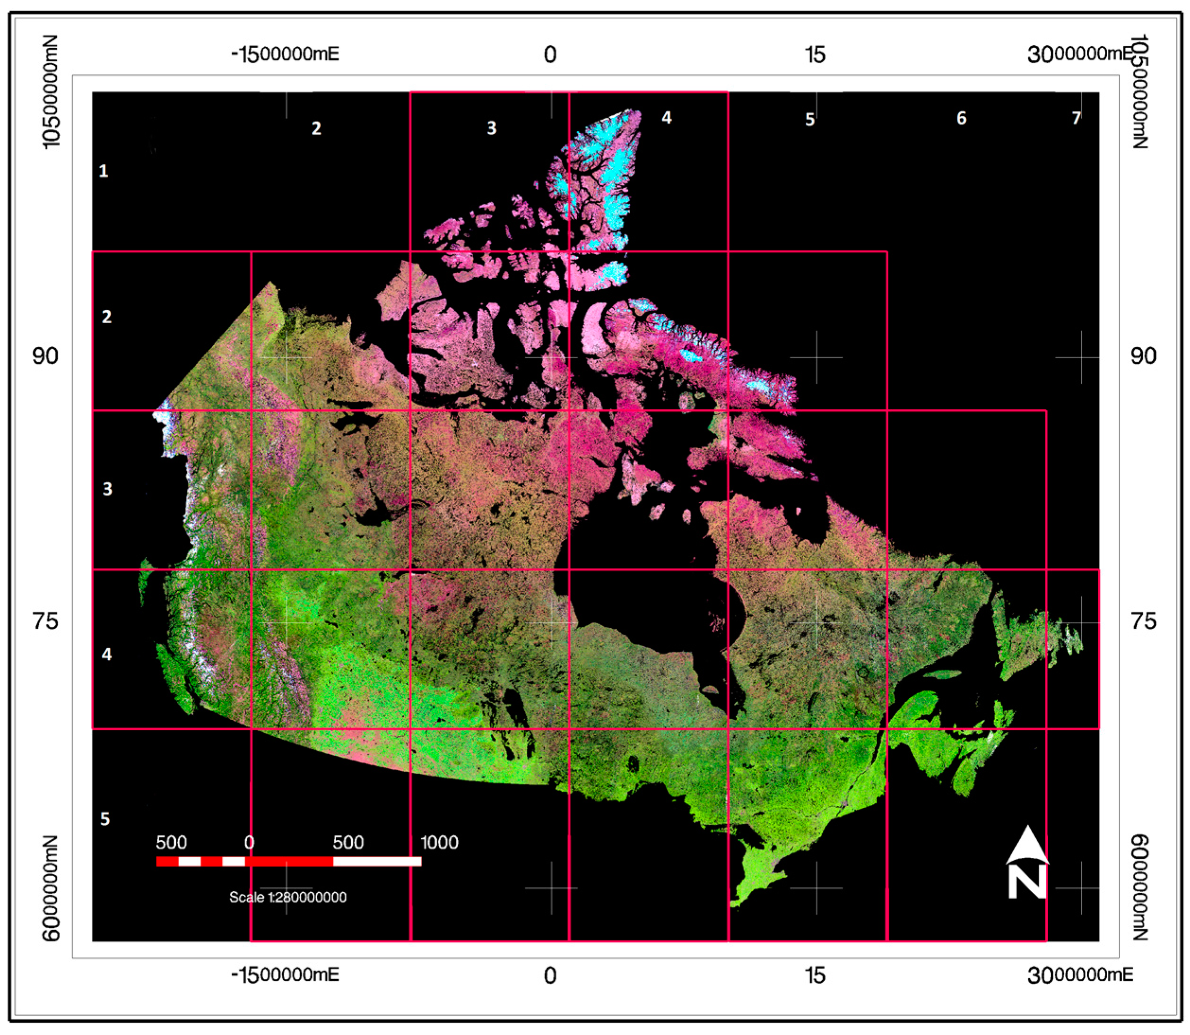
Tile Grid System Used for National Biophysical Mapping
(1) The Canadian landmass is covered by a total of 26 tiles.
(2) Each tile covers a ground area of 900 x 900 square kilometers.
(3) A product image for a tile at 20m resolution contains 45000x 45000 pixels.
(4) A user-defined region can also be utilized for a production
Notes:
The tile grid system used for producing national biophysical maps is identical to the system used for national land cover classification

Slide 4
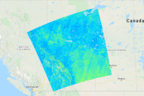
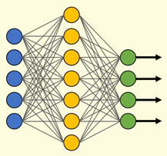
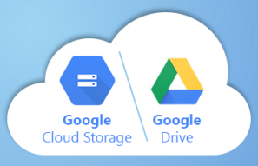
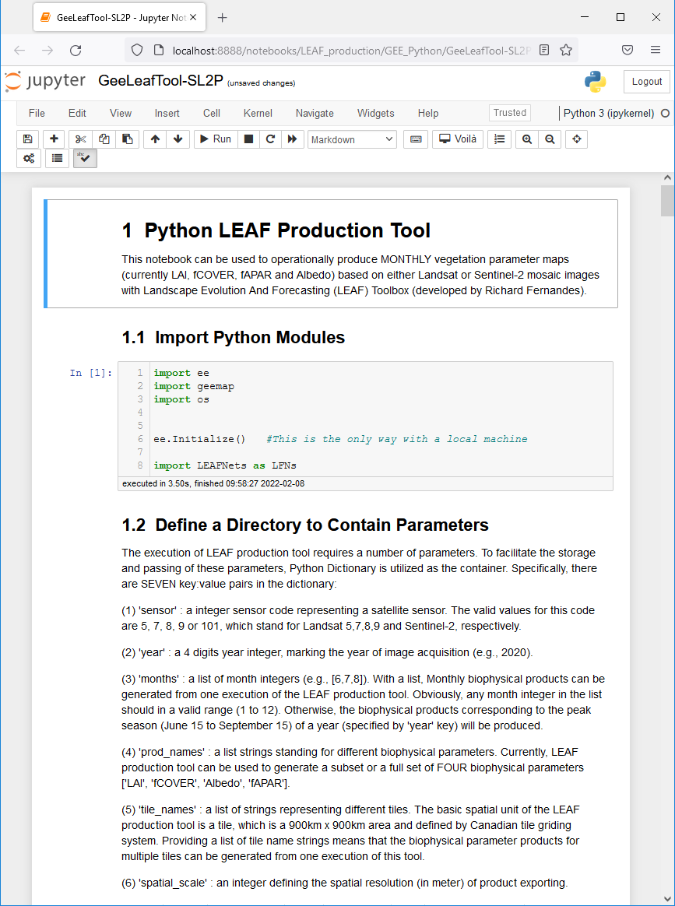
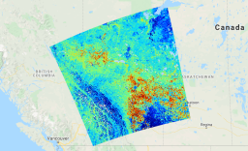
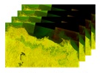
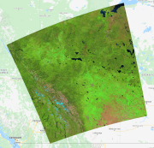
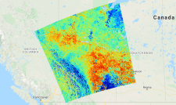

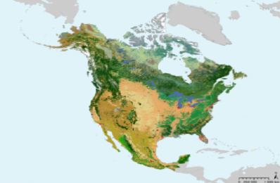
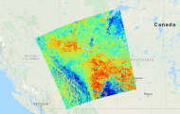
Flowchart of the GEE LEAF Production Tool
Albedo Map
Trained LEAF ANN
LAI Map
GEE Data Catalog
Composited Image
fCOVER Map
Land Cover Map
fAPAR Map
Notes:
GEE LEAF production tool requires three input components:
A set of trained neural networks for different land cover types;
a composite/mosaic image covering a specified area, instead of individual scene in GEE Data Catalog
and a national land cover classification map.
Specifically, different neural networks are applied to the mosaic image according to land cover types.

Slide 5
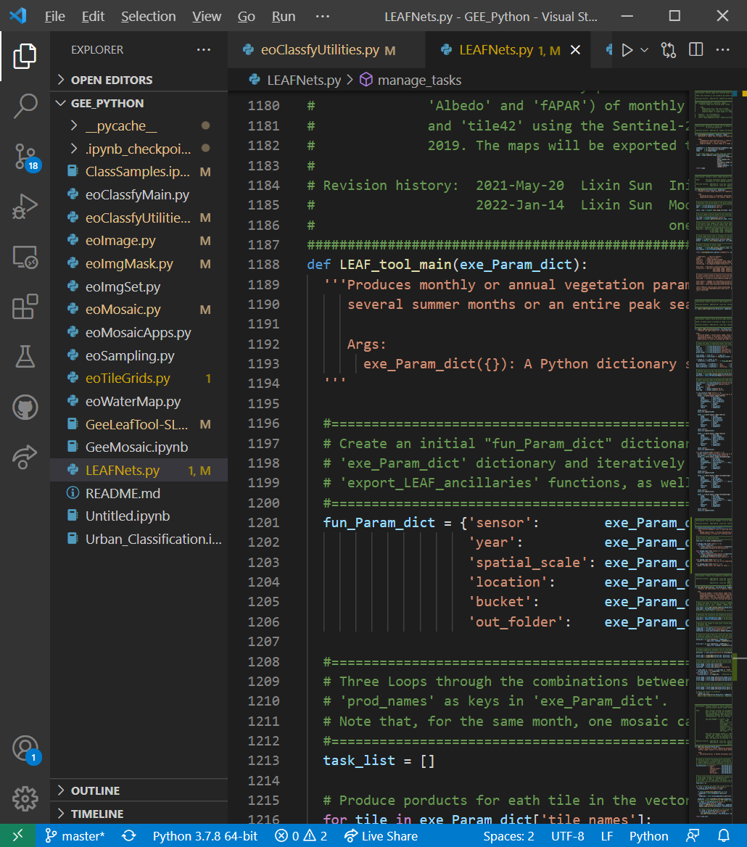
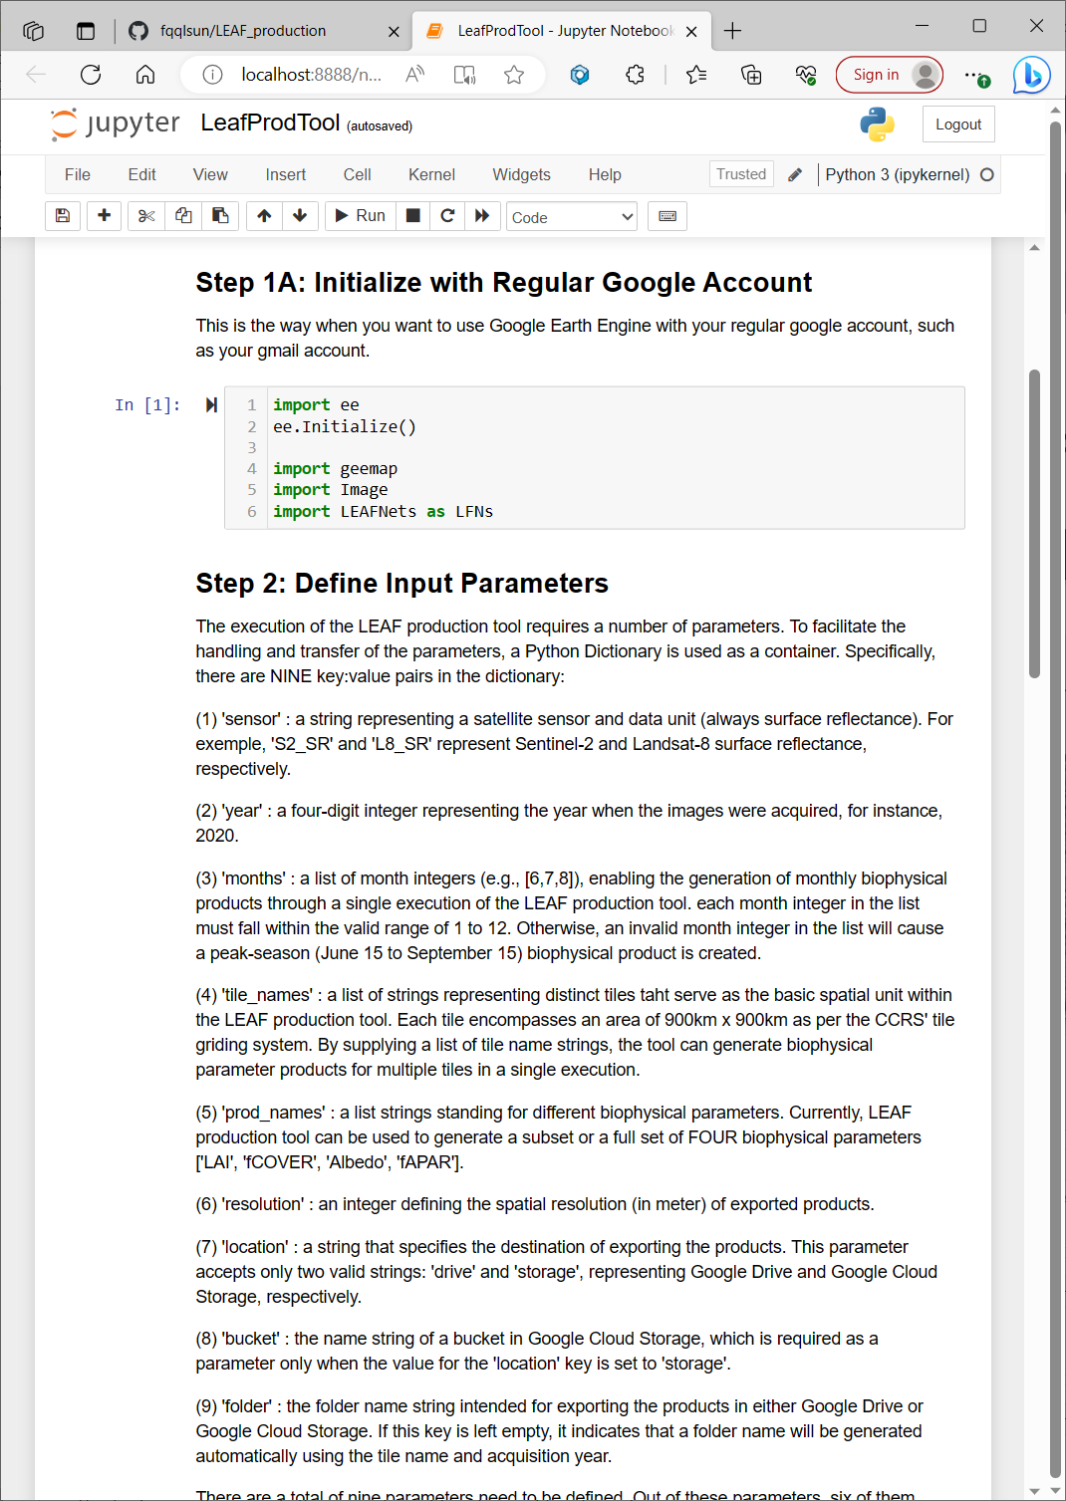
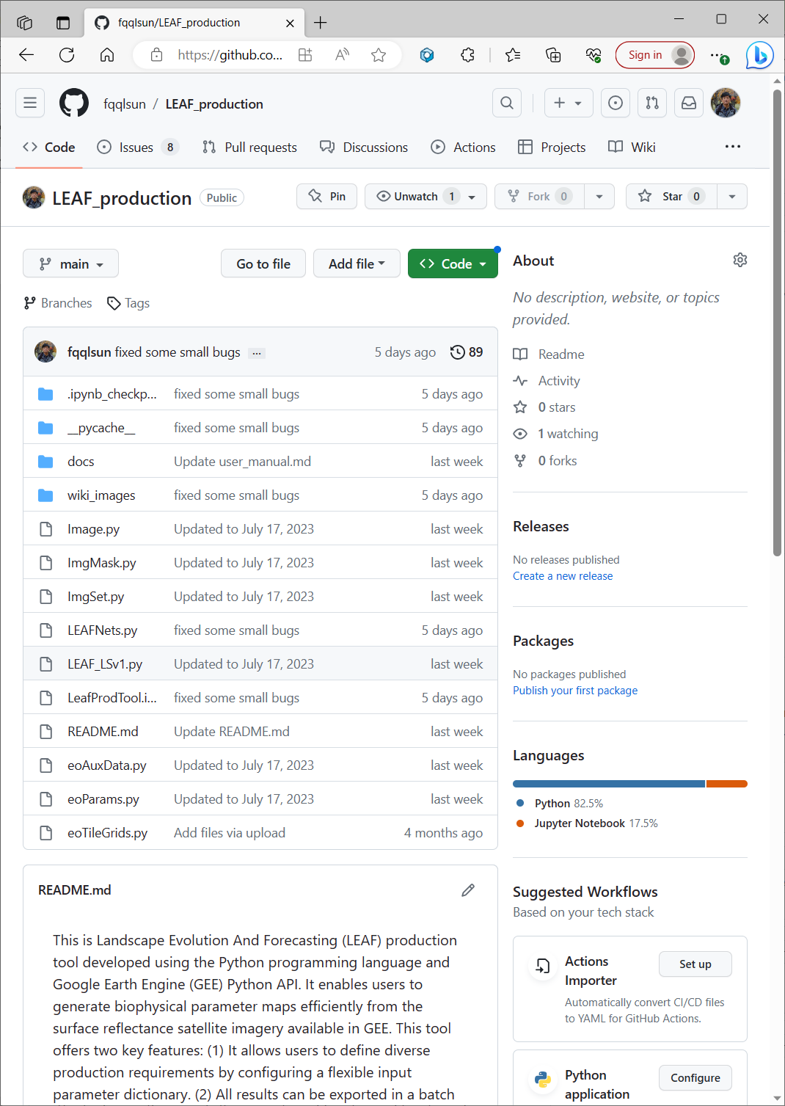
Environments for developing the GEE LEAF Production Tool
Module development with VS Code Execution with Jupyter Notebook Backup with GitHub
Notes:
Generally speaking, three open-source environments/software are involved in the code development for GEE LEAF production tool, and they are Microsoft Visual Studio Code IDE, Anaconda Jupyter Notebook and GitHub.
All the python modules are developed using VS code. This is currently the most popular and powerful free programming IDE offered by Microsoft
Jupyter Notebook is used to define required input parameters and execute GEE LEAF production tool.
All the software code and related documents/instructions are backuped in a publicly accessible repository on GitHub.

Slide 6
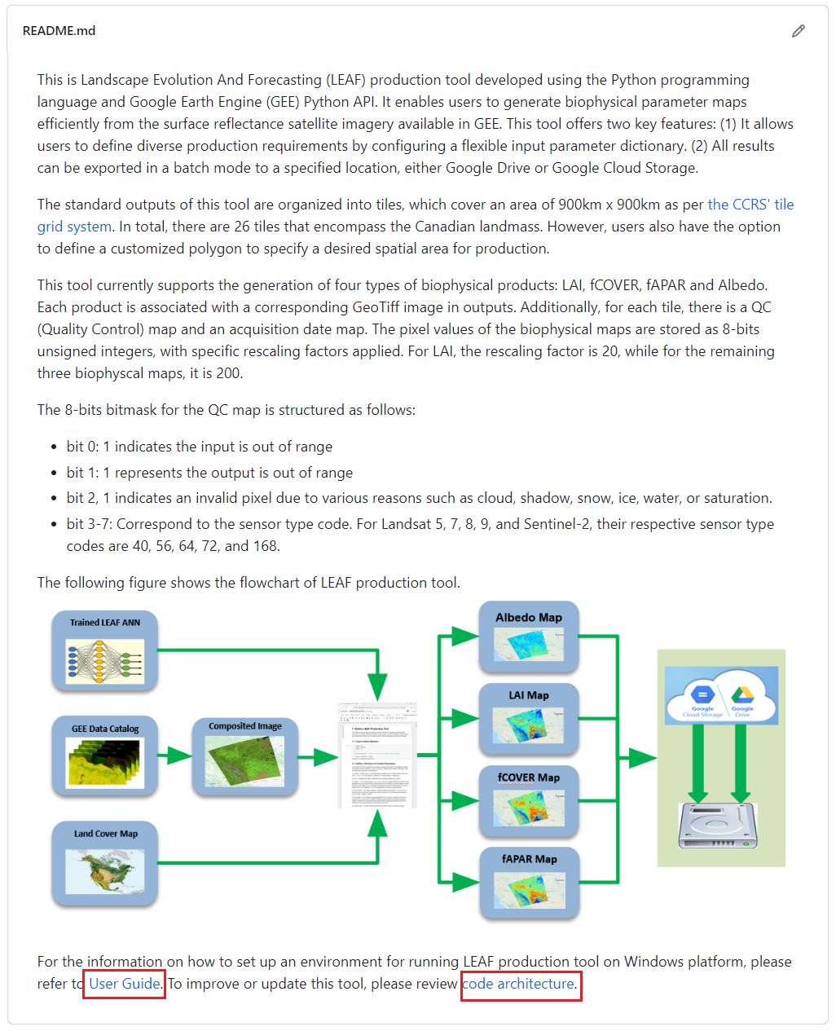
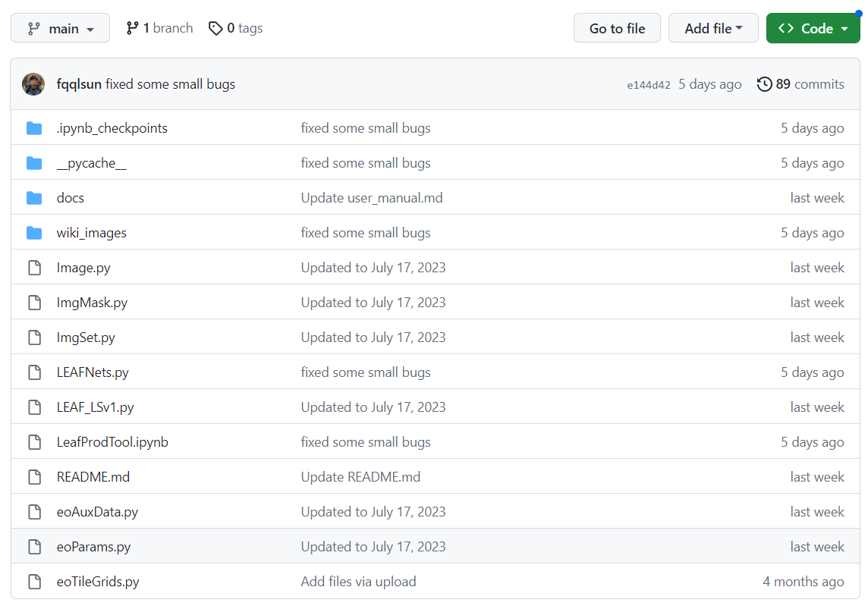
Public GitHub Repository for the GEE LEAF Production Tool (https://github.com/fqqlsun/LEAF_production)
Notes:
The left side is the directory and files in the GitHub repository of GEE LAEF production tool
The right side is the README file. From this file, users can get most information they need to know. For example, User Guide, code architecture, bitmask structure of QC map and CCRS’ tile grid system map

Slide 7
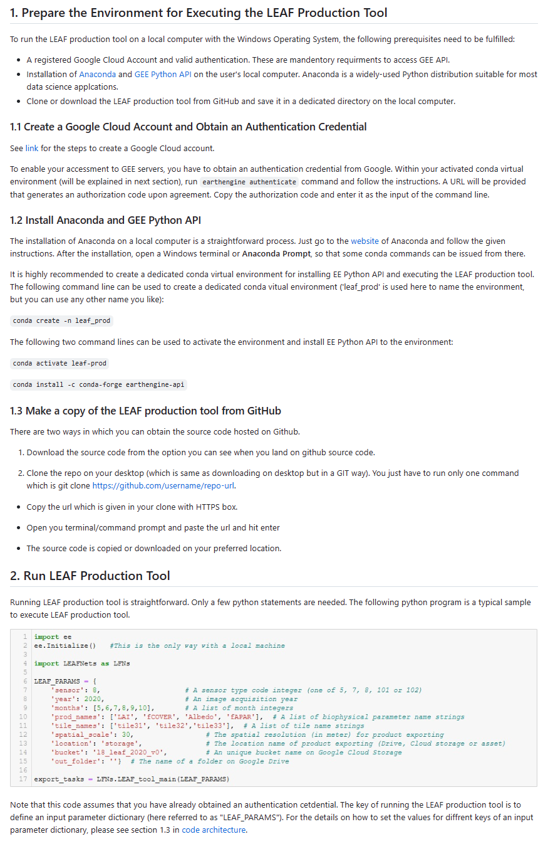
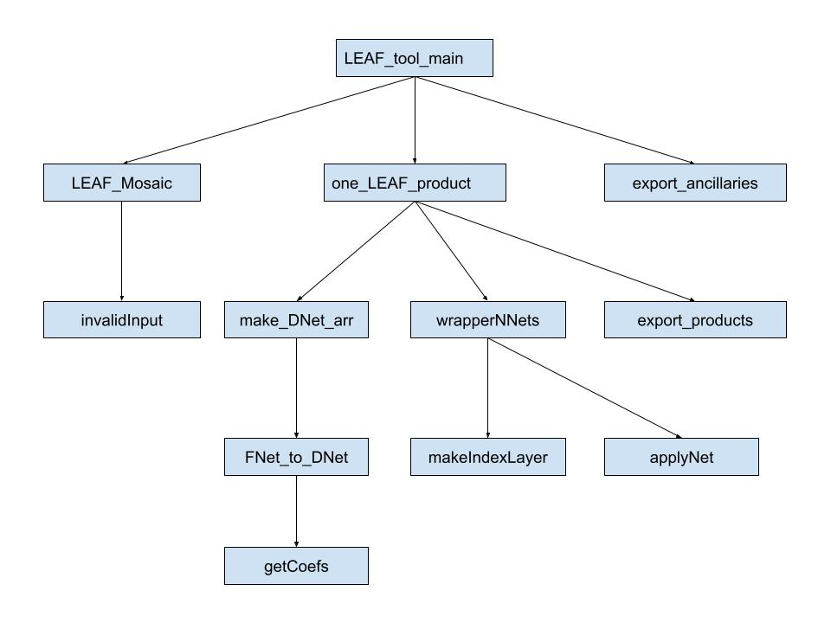
User Guide and Software Architecture

Slide 8
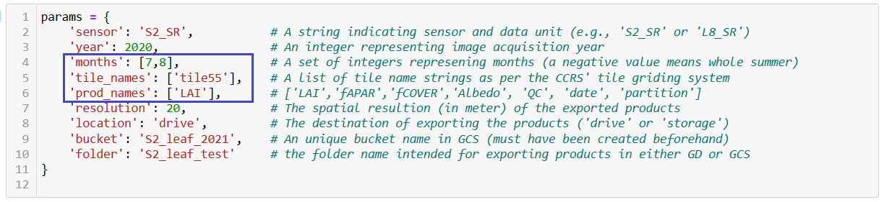
Execution of the GEE LEAF Production Tool
The notebook for running the LEAF production tool includes a dictionary that enables users to specify all
the necessary parameters. With this dictionary, the execution of the LEAF production tool becomes
straightforward and highly flexible.
There are three parameters (marked with blue box) accept lists of values. By using different combinations of the three lists, various production scenarios can be implemented.
For instance:
‘months’: [5,6,7,8,9,10], ‘tile_names’: [‘tile55’], ‘prod_names’: [‘LAI’, ‘fAPAR’, ‘fCOVER’]
‘months’: [5,6,7,8,9,10], ‘tile_names’: [‘tile35’,‘tile55’,’tile44’], ‘prod_names’: [‘LAI’]

Slide 9
Result Format and Exporting Options
The outputs of the LEAF production tool are GeoTIFF images with small overlap between tiles. Each tile covers a ground area of 900 x 900 square kilometers.
The projection of the exported biophysical parameter maps is “EPSG:3979”
For each monthly product, there are a total of 7 associated images, including 4 estimated parameter images, 1 land cover map, 1 acquisition time map, and 1 quality control (QC) map.
The LEAF production tool can export results directly to either Google Drive (GD) or Google Cloud Storage (GCS) at a specified spatial resolution.
The images exported to GD and GCS can be downloaded to local drive through synchronized drive and “gsutil” tool, respectively.
The data stored on the local drive or in GCS can also be transferred to the Federal Science DataHub using AzCopy tool.

Slide 10
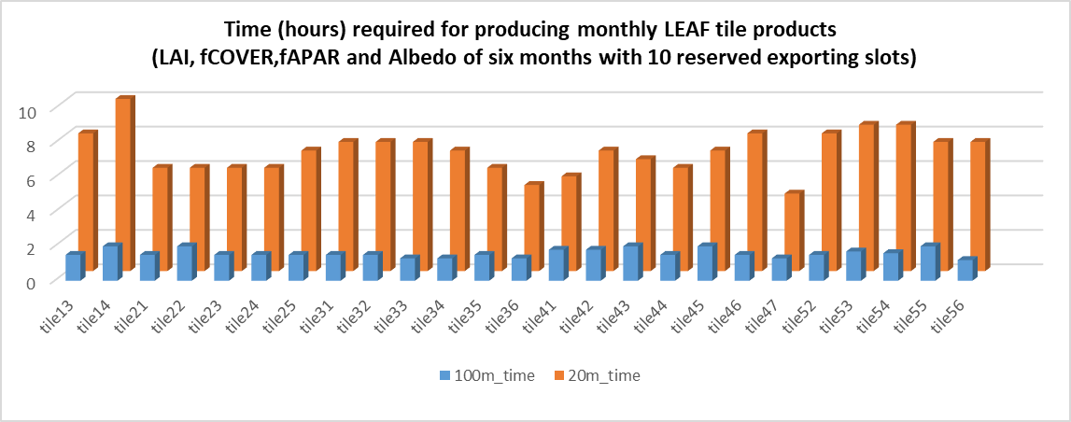
Time Requirements for Different Tiles
When 10 exporting slots are reserved, it takes approximately 175 and 40 hours to generate one year of national 20m and 100m resolution monthly (May to Oct.) biophysical products (LAI, fCOVER, fAPAR and Albedo) using Sentinel-2 data. If a regular Google account is used (typically offering only 5 exporting slots), these time requirements will be doubled.

Slide 11
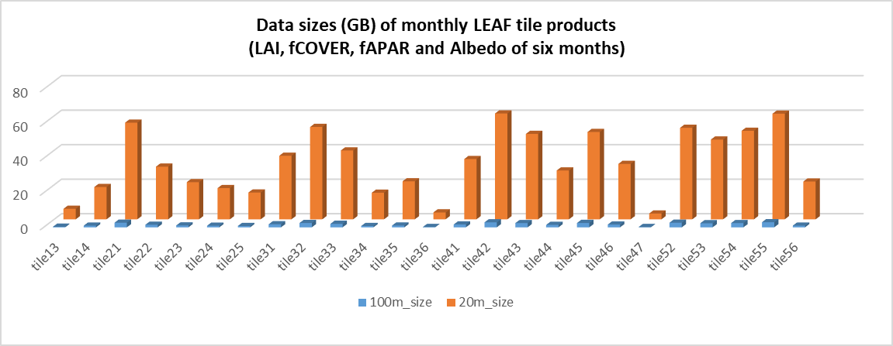
Storage Requirements for Different Tiles
The data volumes of national monthly biophysical products at 20m and 100m resolution, spanning from May to October of a year, are roughly 850 and 45 GB, respectively.

Slide 12
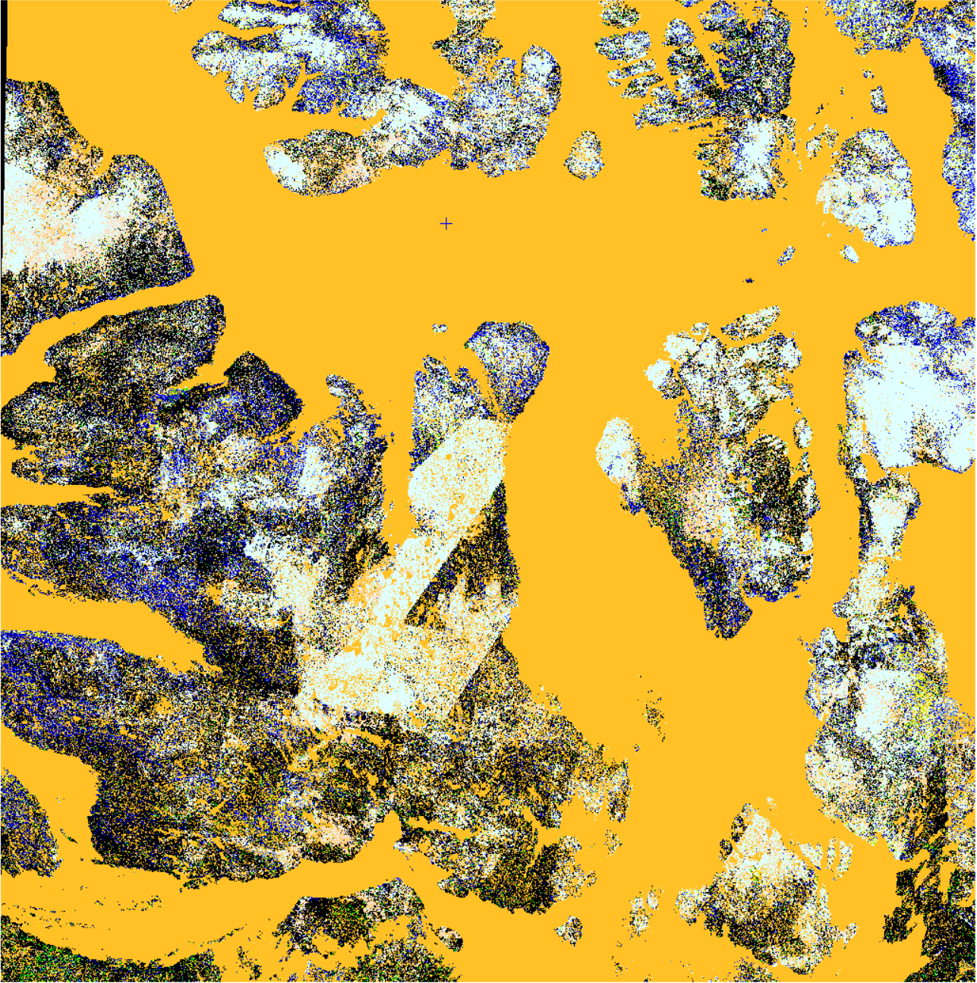
Quality Control Layer in Biophysical Products
The 8-bits bitmask of the QC layer is structured as follows:
bit 0: the value of 1 signifies that the input is out of range
bit 1: the value of 1 represents that the output is out of range
bit 2: the value of 1 indicates an invalid pixel, which can occur due to various reasons such as cloud, shadows, snow, ice, water, or saturation.
bit 3-7: these bits are reserved to store the sensor type codes. For Landsat 5, 7, 8, 9, and Sentinel-2, their respective sensor type codes are 40, 56, 64, 72, and 168.

Slide 13
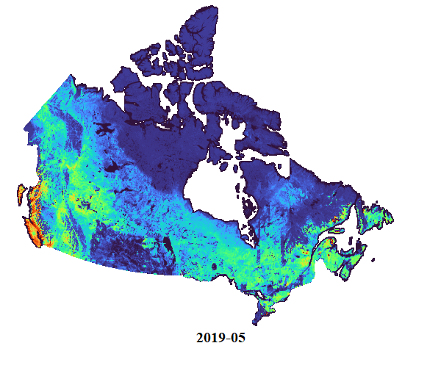
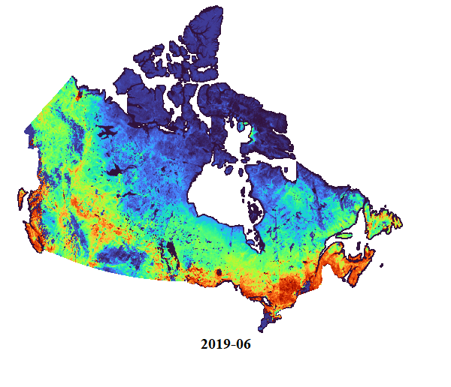
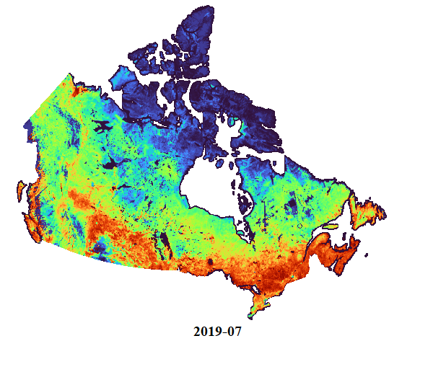
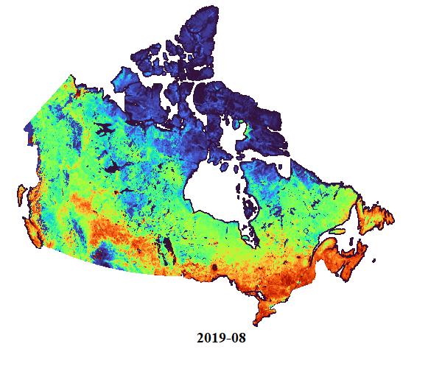
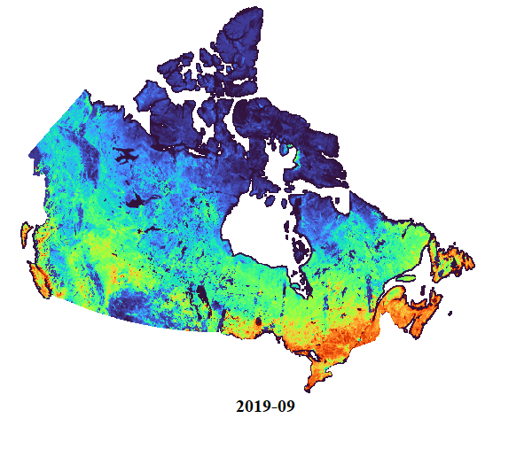
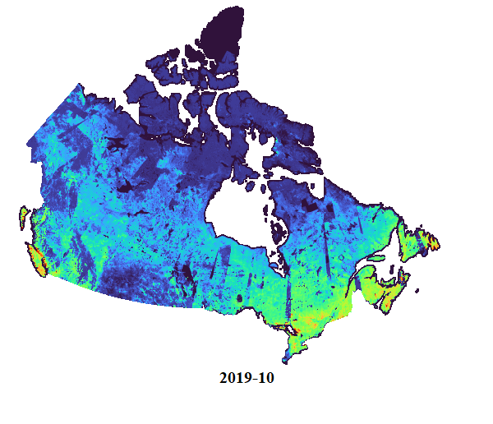
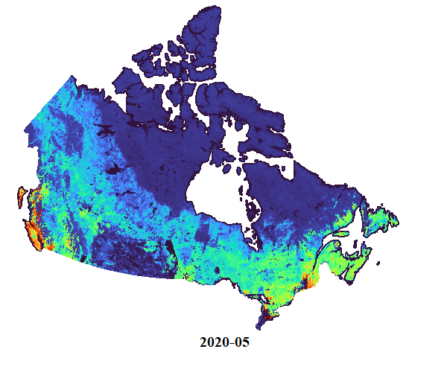
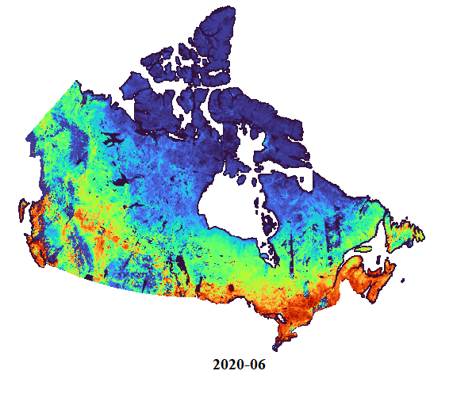
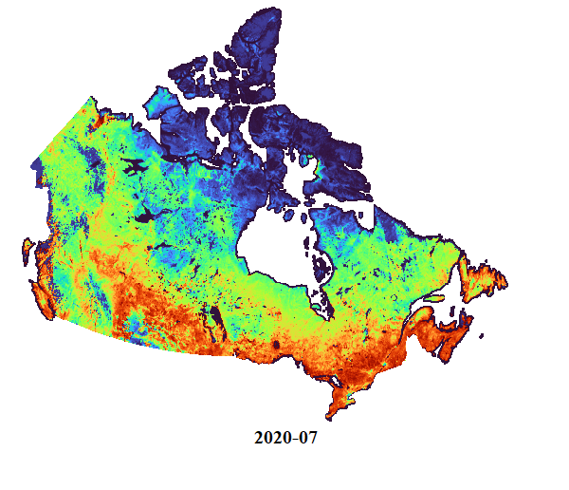
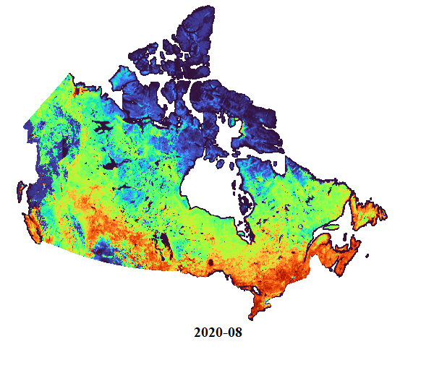
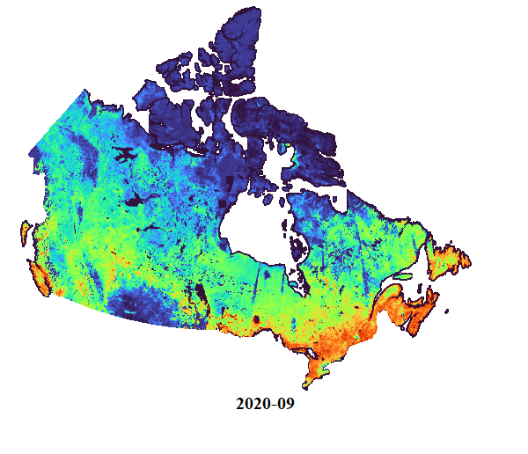
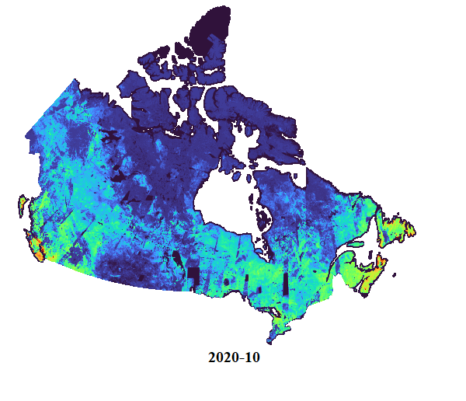
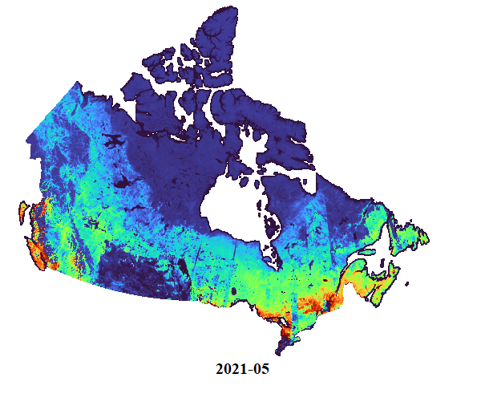
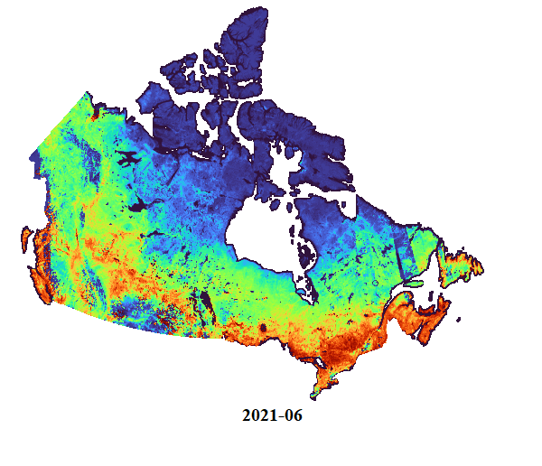

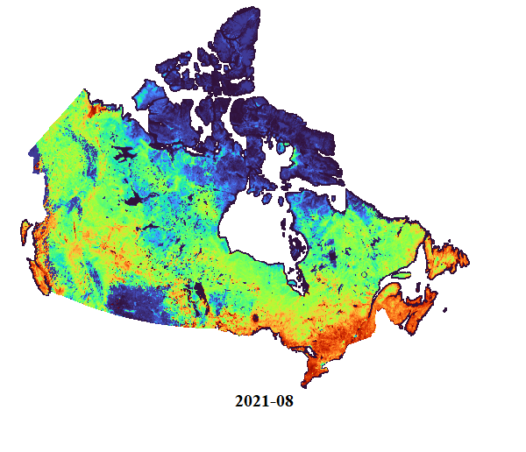
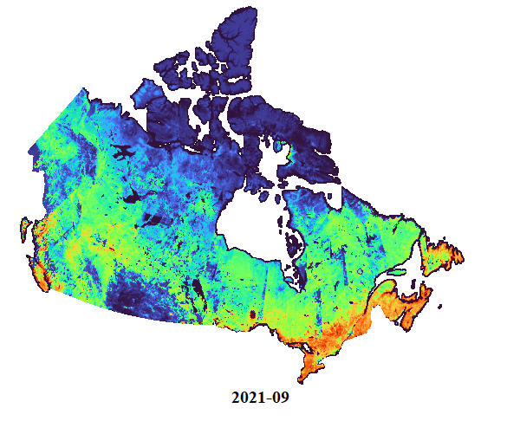
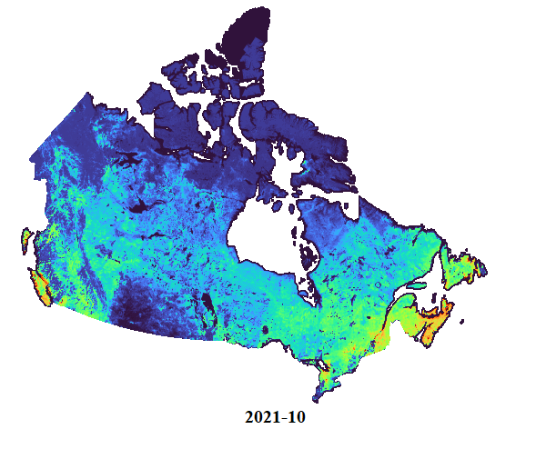
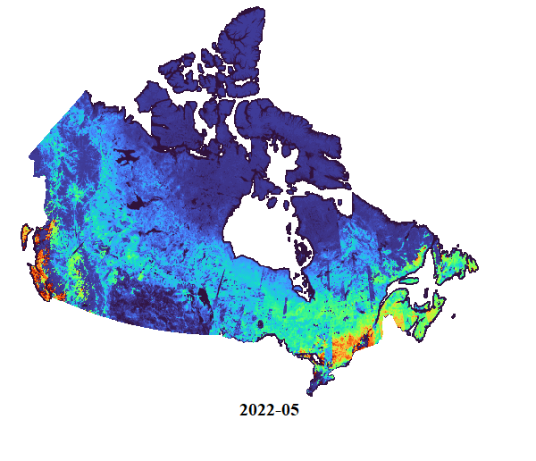
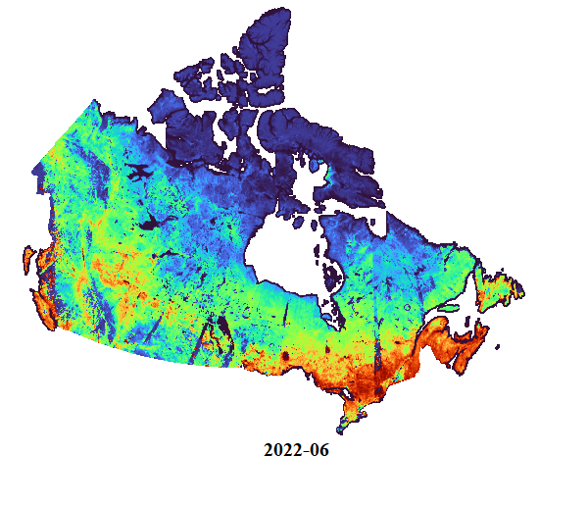
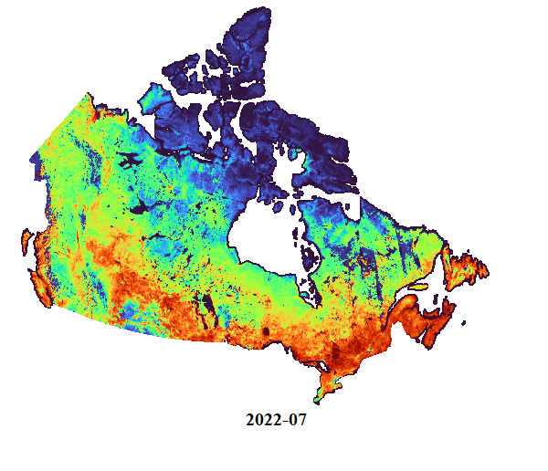
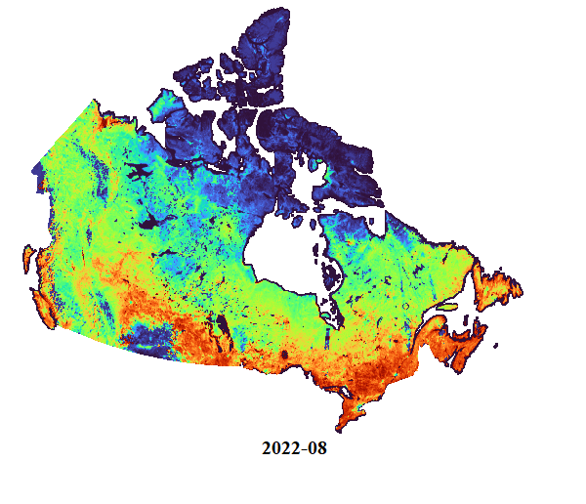
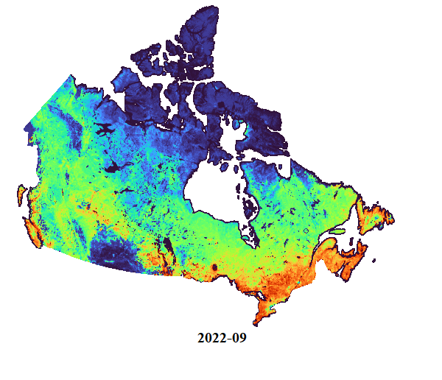
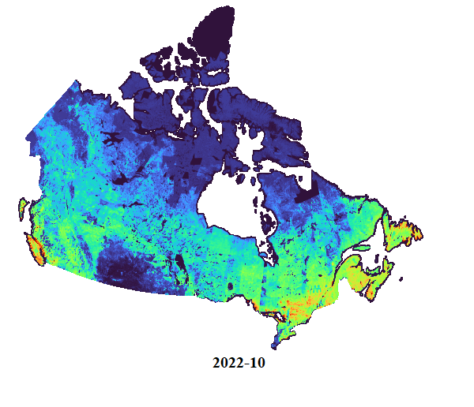
National Monthly LAI Maps from 2019 to 2022

Slide 14
Data Access
Datacube: https://datacube.services.geo.ca/en/viewer/eo4ce/vegetation/monthly-vegetation.html
STAC Catalog – see next slide
OpenGov.ca: https://open.canada.ca/data/en/dataset/37745ea7-d0cf-4ef6-b6b8-1cb3a7fce0b8
Science Data Hub (until October, 2023; ask richard.fernandes@nrcan-rncan.gc.ca for access): SSC Datahub - CCRS (canada.ca)

Slide 15
STAC Catalog Access
collection endpoint for the Monthly Vegetation Parameters: https://datacube.services.geo.ca/api/collections/monthly-vegetation-parameters-20m-v1
list all the items available under this collection from this link: https://datacube.services.geo.ca/api/collections/monthly-vegetation-parameters-20m-v1/items (24 items)
Or perform spatial/temporal searches using queries such as the following:
https://datacube.services.geo.ca/api/search?collections=monthly-vegetation-parameters-20m-v1 (entire collection – 24 items)
https://datacube.services.geo.ca/api/search?collections=monthly-vegetation-parameters-20m-v1&datetime=2019-01-01T00:00:00Z/2019-12-31T00:00:00Z (Year 2019 – 6 items)

